Slide 1

Comparing The Regression Models (Used Phone Dataset)
Presented By: Si Thu

Slide 2
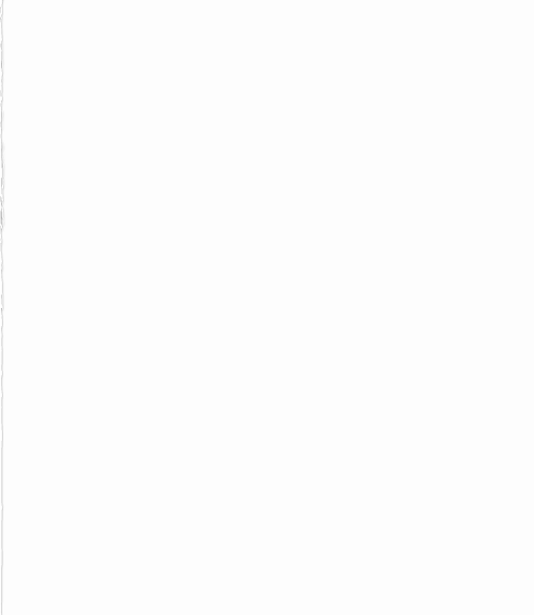
Agenda
Dataset Source
Objectives
Features
EDA
Implementation
Observation and Limitation

Slide 3

Dataset Source
This dataset was acquired from Dr. Myo Thida in Supervised Machine Learning Course (Parami University).
This dataset containing used phone price records of 3454 entries and total 15 columns.

Slide 4
Objectives
To compare the regression models of this dataset and comparing their performance can help in selecting the best model.
To develop the accuracy of predicted value from different regression models.

Slide 5
Features
This data set has 15 features and 3454 records. Features are as follows:
Device Brand (Object: Separated by One-hot Encoding Method)
OS (Object: Separated by One-hot Encoding Method)
Screen size (Float)
4g (Object: yes or no replace to 1 or 0)
5g (Object: yes or no replace to 1 or 0)
Rear camera MP ( Float)
Front camera MP (Float)
RAM (Float)
Battery (Float)
Weight (Float)
Release Year (Int)
Days Used (Int)
Normalized Used Price (Float)
Normalized New Price (Float)

Slide 6
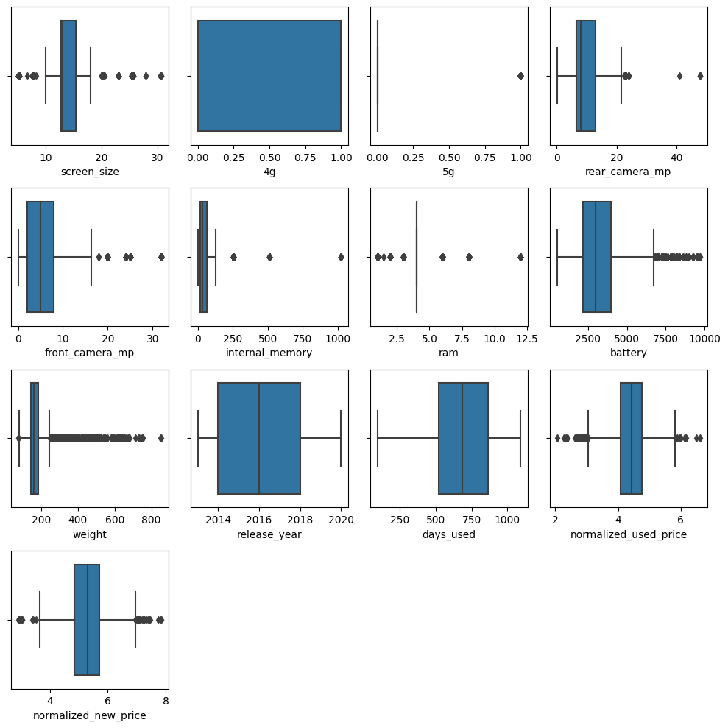
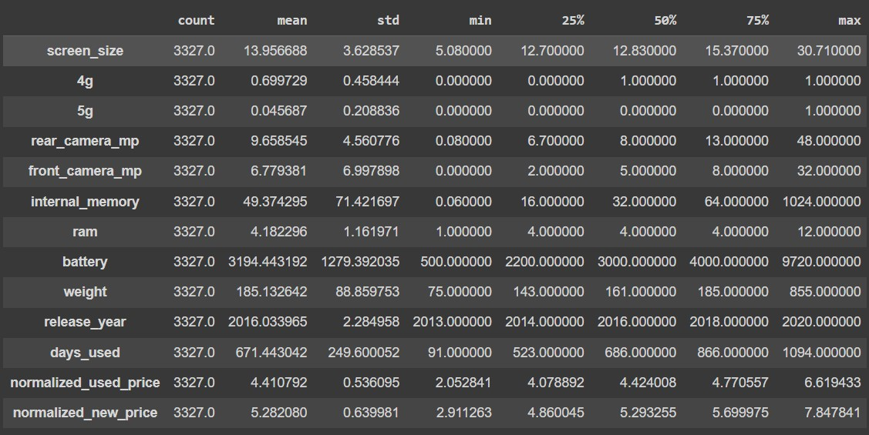
EDA
Shown the dataset info :
Shown the data describition.
Check the features and missing values.
Filling the missing values (I filled up the Median number).
Finding the outlier data and remove its.
Cont’d

Slide 7
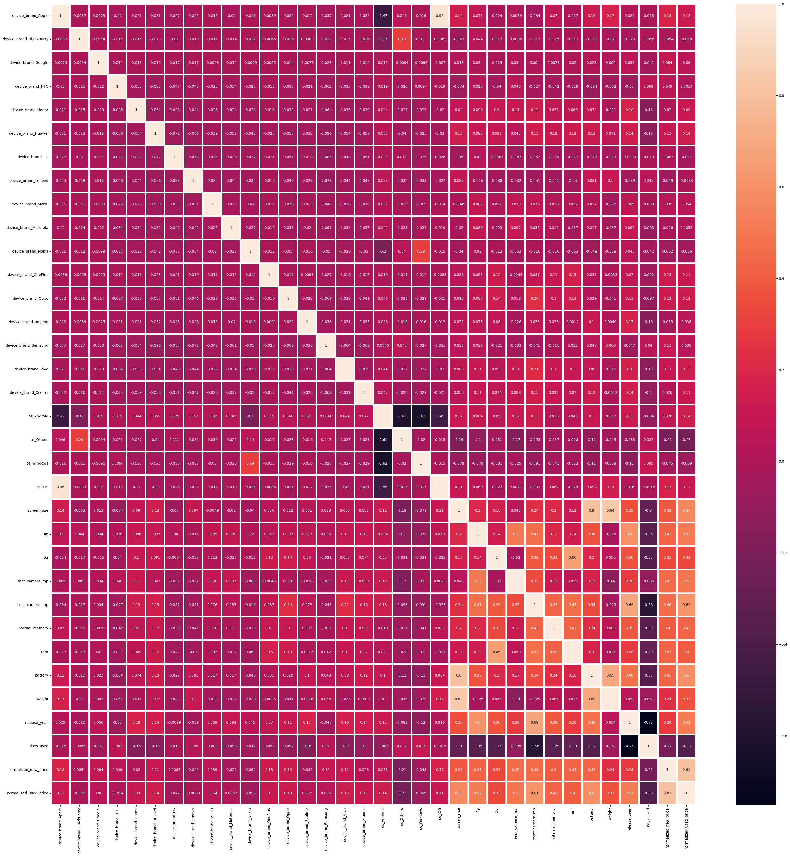
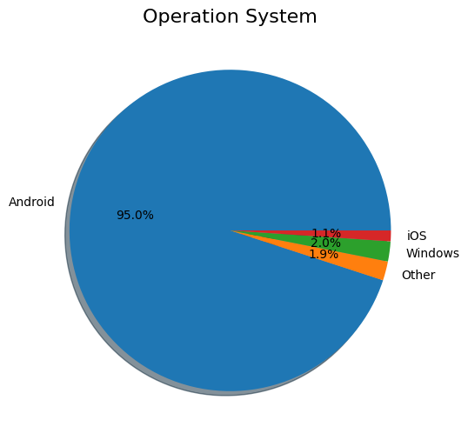
EDA
Features ( Device Brand & OS) changed from objective to number using the One-hot encoding method.
Features (4G & 5G) changed from objective to number using the replace function from yes/no to 1 and 0.
Shown the Heat Map.

Slide 8
Implementation
Train Test Split:
Test size = 30%
999 entries
Train Size = 70%
2328 entries
Random state used 42
Cont’d

Slide 9
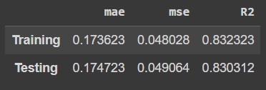
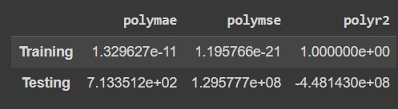
Implementation
Linear Regression
Polynomial Regression
Implementation of Linear Regression Model.
Training and Testing evaluation result are as follow:
From my Polynomial Regression Model have Over-fitting Problem.
So I drop this model.
Cont’d

Slide 10
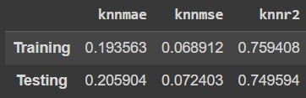
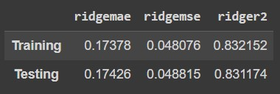
Implementation
KNN Regressor
Ridge
Finding the best K-value
The best K-value = 15.
Implementation the KNN regressor model.
Training and Testing evaluation result are as follow:
Finding the best Alpha value
The best Alpha value = 10.
Implementation the Ridge regression model
Training and Testing evaluation result are as follow:
Cont’d

Slide 11
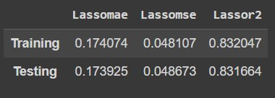
Implementation
Lasso Regression
Finding the best Alpha value
The best Alpha value = 0.0003351602650938841.
Implementation the Lasso regression model.
Training and Testing evaluation result are as follow:

Slide 12
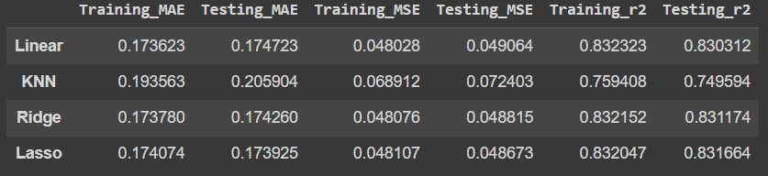
Result of all Models

Slide 13
Observation and Limitation
Observation
Limitation
I recommended the Lasso Regression Model by the results of all models.
Lasso Regression model have highest R-squared(r2) score in testing data.
Linear, Ridge and Lasso regressions models of the evaluation results (MAE, MSE & r2) is nearly similar.
Normalized Used Price & Normalized New Price, these two features have normalized number.
Device models are not included in this dataset.
Some of device brand are not used in our country (e.g. Alacetel, Lava, Celkon, etc)

Slide 14
“Thank You”
Q & A

